Slide 1
Baseball Facial Recognition & Justice League Housing Price Prediction
By Vamsi Chinta, Faraz Mirza, Nykosi Hollingsworth [Team 3]
Aka ‘Power Buff Boys!’

Slide 2

Justice League Housing Prices

Slide 3
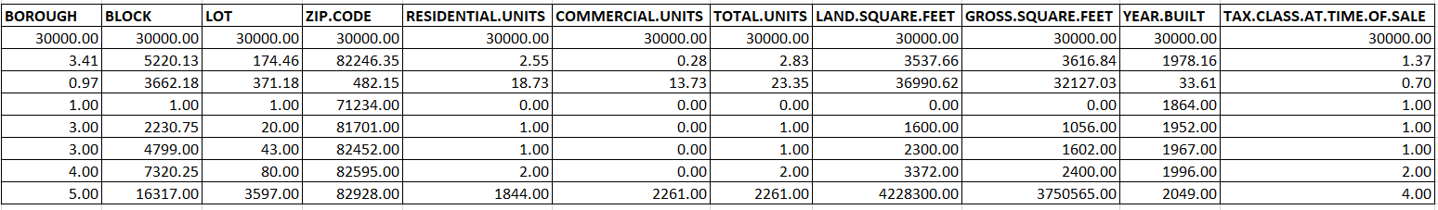
Understanding the Data
Total Records: 30,000
Total Features: 18
Target Feature: Sale Prices of Houses

Slide 4
Data Preprocessing
Derived Two New Features:
Features Derived from: SALE DATE and YEAR.BUILT (Datetime)
Derived Feature 1: Recent_Year_Sale = (2049 - SALE.DATE.year) + 1
Derived Feature 2: Recent_Year_Built = 2049 - YEAR.BUILT
They represent the age of the building and years since it was last sold.

Slide 5
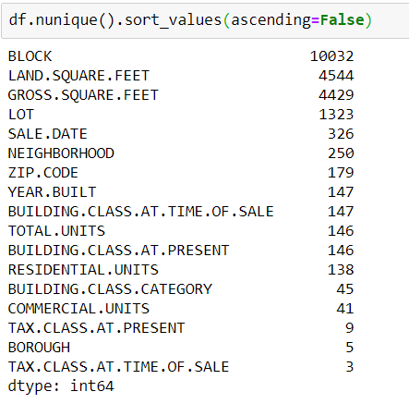
Label Encoding and One Hot Encoding
Most of the features were categorical and contained very large number of classes. Block feature having the most.
Although most of the features were nominal, I still applied label encoding just to make it a little less messy. Land sq ft, Gross sq ft and the derived features were left out since they were Numerical. After Label Encoding, I applied One Hot Encoding on them so the order didn’t matter.

Slide 6
Min-Max Normalization
Since most of our features are now binary containing either 0 or 1, we had to scale our Numerical features between that range as well.
Min-Max Scaling applied on:
Gross sq ft, Land sq ft, Recent_Year_Sale and Recent_Year_Built

Slide 7
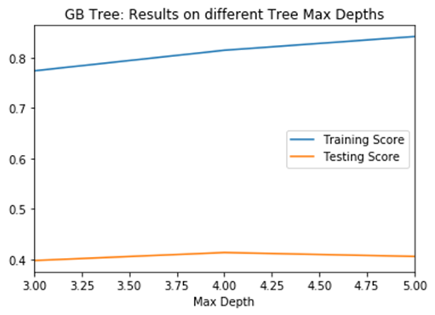
Random Forest Regressor
Now that we got our data ready, we split them up into training and testing tests and fitted them in Random Forest Regressor model on multiple max_depths. Since we had 12,468 features now, it was very computationally heavy to run it on a large range of values.
Random Forest Regressor had the best test scores on max_depth=4 with n_estimator=200.

Slide 8
Feature Selection
Top 10 Features:
'GROSS.SQUARE.FEET',
'ZIP.CODE_42',
'BLOCK_1100',
'COMMERCIAL.UNITS_28',
'LAND.SQUARE.FEET',
'BLOCK_26',
'BOROUGH_0',
'RESIDENTIAL.UNITS_135', 'BUILDING.CLASS.AT.TIME.OF.SALE_98', 'COMMERCIAL.UNITS_32'
Out of 12,468 Features, only 262 features had a non-zero importance score but even from them, the values were so small, these features hardly had any impact on the prediction power of the model.
I chose top 50 for my final model. The Training and testing scores remained constant.

Slide 9

Baseball Player’s Facial Recognition

Slide 10
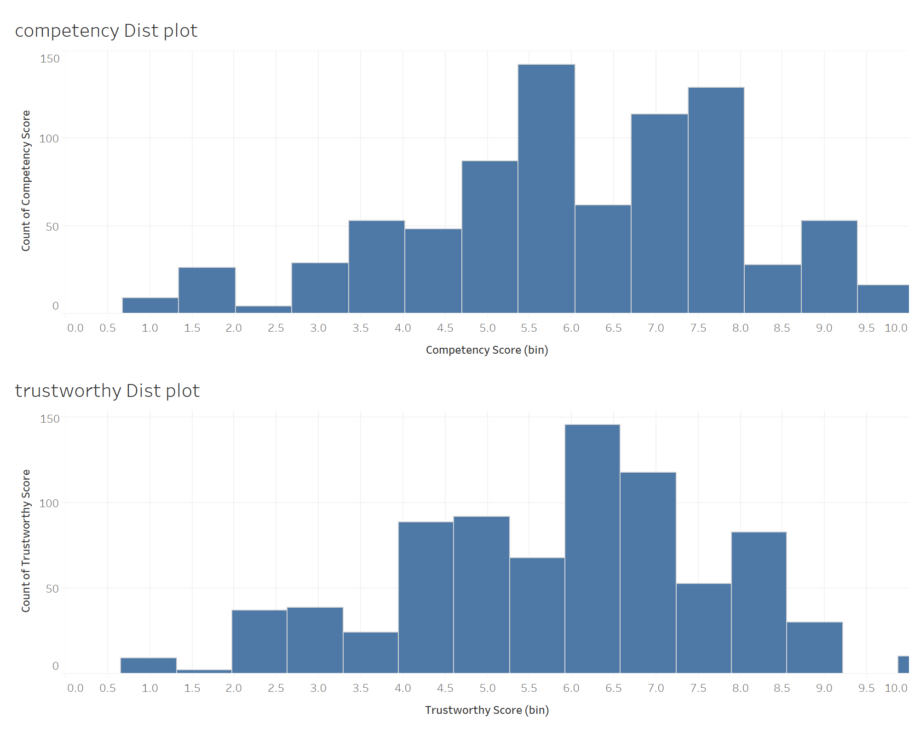
Understanding the Data
Descriptive Features
800 Images of BaseBall Players
Target Features
Trustworthiness & Competency

Slide 11


Data Preprocessing
Data Augmentation
rescale = (1/255)
Rotation range = 5 - 20
Feature-wise normalization = False
Sample-wise normalization = True
Notes:
Pooling Layers
Its function is to progressively reduce the spatial size of the representation to reduce the amount of parameters and computation in the network, and hence to also control overfitting.

Slide 12
Vanilla CNN - Key Parameters
Architecture Parameters
# of Convolution layers
# of Pooling layers
Adding Dropout
# of Dense (fully connected) layers
# of target features [1 vs 2]
Model Parameters
Loss functions
Optimizer functions ‘Learning rate fn’
Kernel Size [(1,1) - (4,4)]
Strides [1 - 2]
Dropout range [(0 - 50%)]
# of Filters [32 - 128]
Batch size [19 for training, 4 for validation]
# of Epochs [5 - 100]

Slide 13
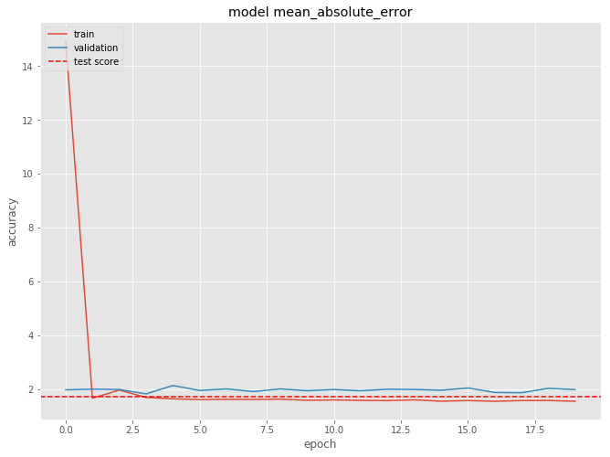
Results
Architecture Parameters
# of Convolution layers = 1
# of Pooling layers = 1
# of Dense layers = 2
# of target features = 2
Model Parameters
Loss functions = MSE
Optimizer functions = Adagrad
Kernel Size = (2, 2)
Strides = (1, 1)
Dropout range = 25%
# of Filters = 32
# of Epochs = 20
Batch size [19 for training, 4 for validation]
Best Model: 1.56 Test MSE

Slide 14
Alternative Structures

Slide 15
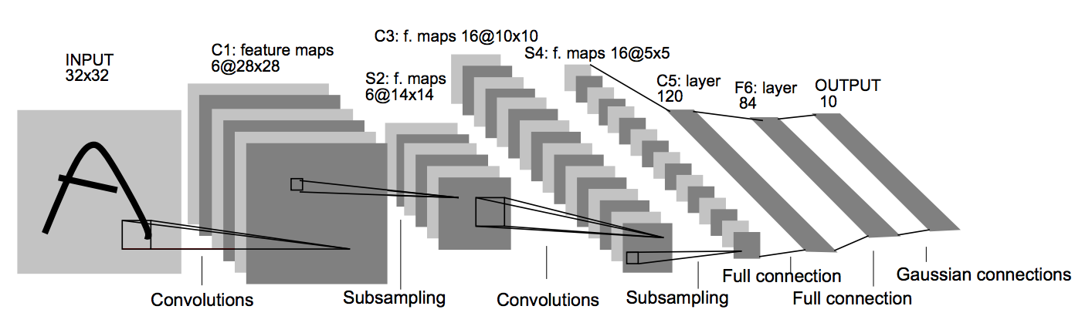
LeNet-5
This pioneering model largely introduced the convolutional neural network as we know it today.
Notes:
Pooling Layers
Its function is to progressively reduce the spatial size of the representation to reduce the amount of parameters and computation in the network, and hence to also control overfitting.

Slide 16
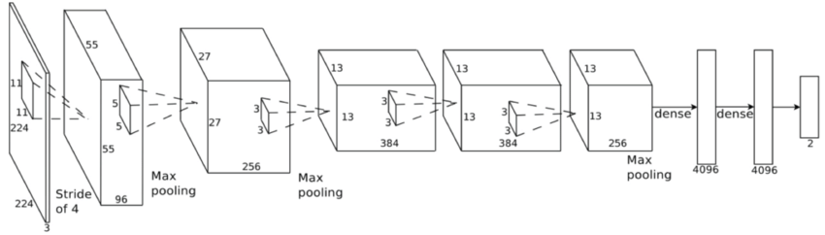
AlexNet
The success of this model in the ImageNet competition convinced the computer vision community to take a serious look at deep learning.
Notes:
Pooling Layers
Its function is to progressively reduce the spatial size of the representation to reduce the amount of parameters and computation in the network, and hence to also control overfitting.

Slide 17
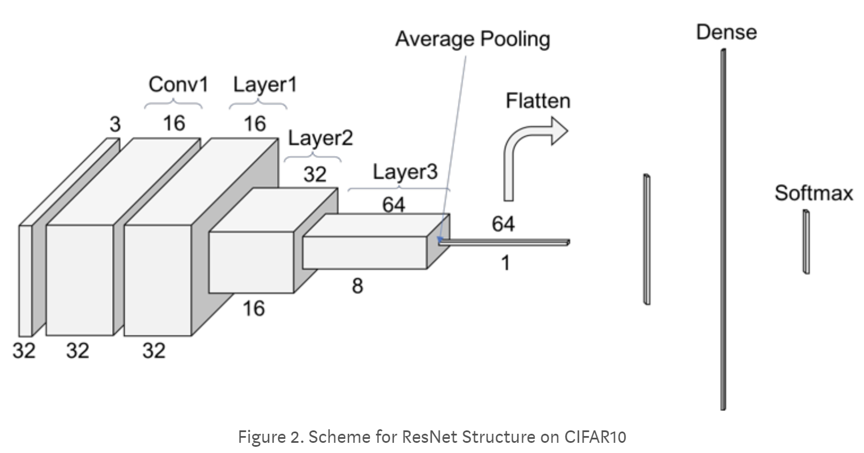
ResNet
Combats the Vanishing gradient problem by using residual blocks and an identity function
Notes:
ResNet
Pooling Layers
Its function is to progressively reduce the spatial size of the representation to reduce the amount of parameters and computation in the network, and hence to also control overfitting.

Slide 18
Questions?

Slide 19
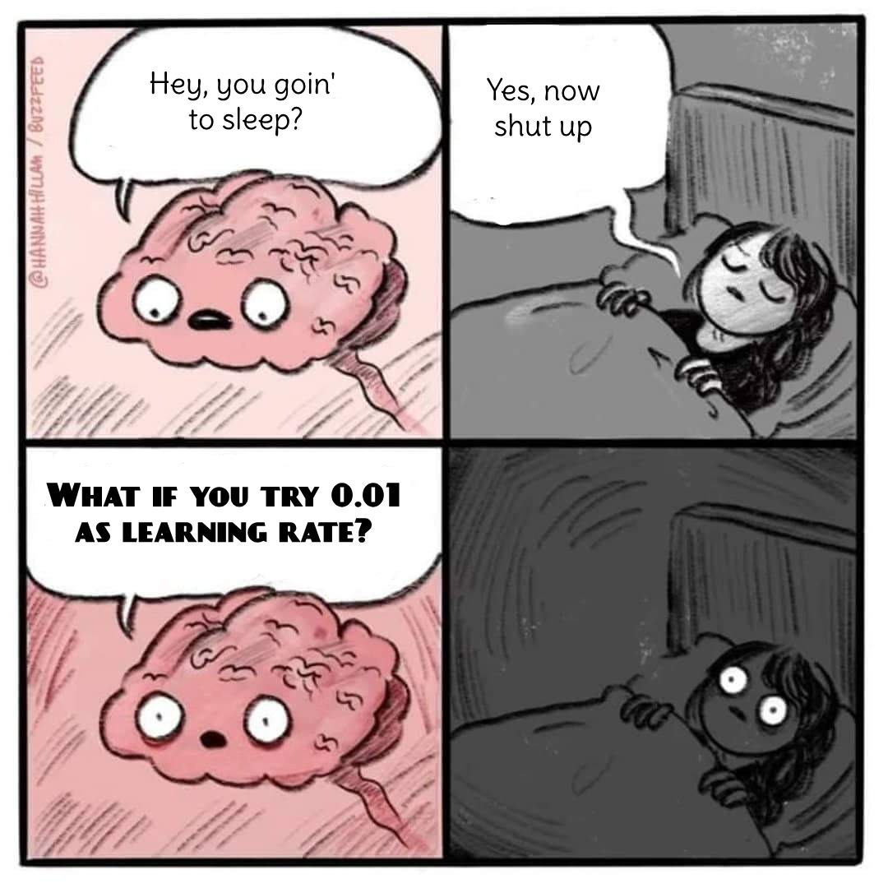

Slide 20
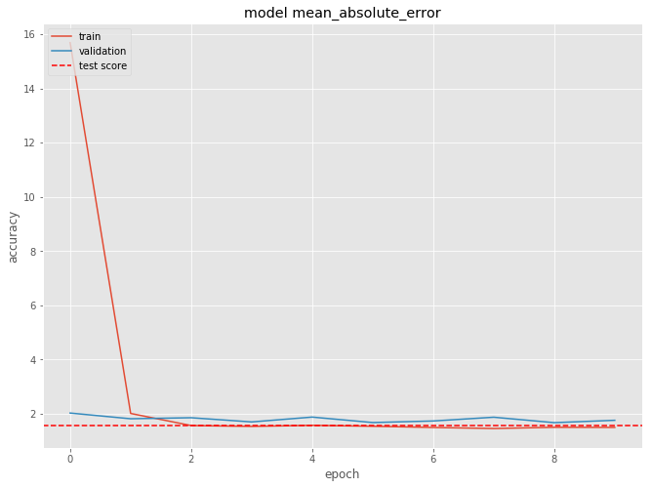
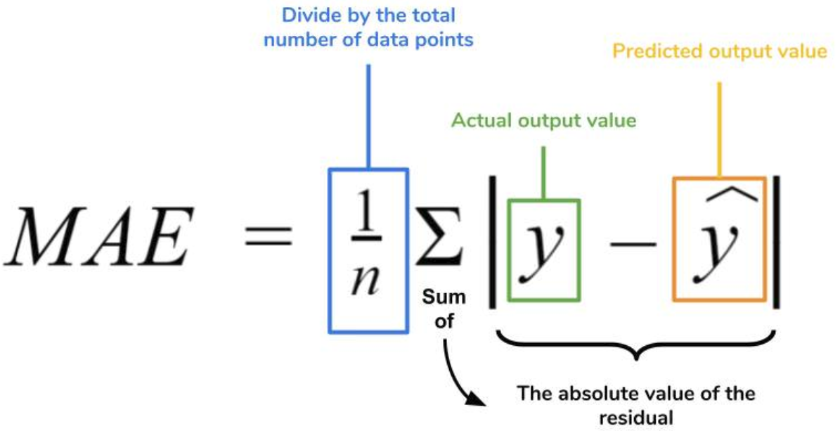
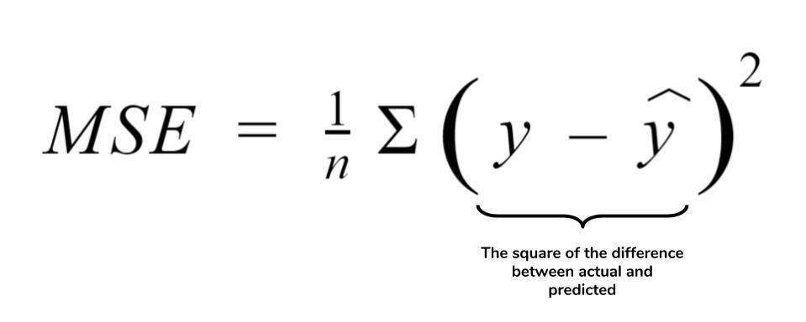
Tuning - Performance Driven
Score Chart
Performance Metric = Mean Absolute Error
Loss Metric = Mean Squared Error
Optimizer = AdaGrad with a learning rate of 0.01 & decay of 0.0001

